Slide 1

Background
to Supply

Slide 2
The Theory of Production
Production is the process by which inputs are combined, transformed, and turned into outputs.
A firm is a production unit where goods and services are produced.
The three decisions that all firms make are:
How much will be produced?
What combination of inputs will be used?
How much profit will be made?
Notes:
2

Slide 3
Profit and the aims of a firm
It is assumed that firms are in business to make profit and that a firm’s behaviour is guided by the goal of maximizing profits.
Traditional theory of the firm
The analysis of pricing and output decisions of the firm under various market conditions, assuming that the firm wishes to maximise profit.
Alternative theories of the firm
Theories of the firm based on the assumption that firms have aims other than profit maximisation.
Notes:
2

Slide 4
Short-run theory of production
  There are two inputs in production:
  Fixed factor
  Variable factor
  then
    A fixed factor is an input that cannot be increased in supply within a given time period (e.g. buildings, land).
    A variable factor is an input that can be increased in supply within a given time period. (e.g. labour)
The distinction between fixed and variable factors allows us to distinguish between the short run and the long run.
Notes:
2

Slide 5
Long-run and short-run production
There are two periods in production:
Short-run
Long-run
  A short-run is the period of time over which at least one factor is fixed.
  In the short run, then, output can be increased only by using more variable factors.
  A long-run is the period of time long enough for all factors to be varied.
  In the long run, there are no fixed factors of production.
Notes:
2

Slide 6
Short-run production function
A production function is a mathematical expression of a relationship between inputs and outputs. It shows units of total physical product (TPP) as a function of units of inputs.
TPP = f (Q_{f} , Q_{v})
where Q_{f} is the quantity of fixed factors
and Q_{v} is the quantity of variable factors
TPP = f (L, K)
This states that total physical product (i.e. the output) over a given period of time is a function of (i.e. depends on) the quantity of fixed land (K) and variable labour (L) employed.
Notes:
2

Slide 7
Average Physical Product (APP)
Average physical product is the average amount produced by each unit of a variable factor of production.
  The APP is given by:
APP = TPP/Qv
  This is output (TPP) per unit of the variable factor (Qv).
Notes:
2

Slide 8
Marginal physical product (MPP)
Marginal physical product is the additional output that can be produced by adding one more unit of a specific input, holding all other inputs constant.
  The MPP is given by:
MPP = ΔTPP/ΔQv
  This is the extra output (ΔTPP) produced by employing one more unit of the variable factor (ΔQv).
Notes:
2

Slide 9
Wheat production per year from a particular farm (tonnes)

Slide 10
Wheat production per year from a particular farm (tonnes)

Slide 11
Wheat production per year from a particular farm (tonnes)

Slide 12
Wheat production per year from a particular farm (tonnes)

Slide 13
Land | Labour | Total Output | APL | MPL
5 | 0 | 0 | - | -
5 | 1 | 50 | 50 | 50
5 | 2 | 150 | 75 | 100
5 | 3 | 300 | 100 | 150
5 | 4 | 400 | 100 | 100
5 | 5 | 480 | 96 | 80
5 | 6 | 540 | 90 | 60
5 | 7 | 580 | 83 | 40
5 | 8 | 610 | 76 | 30
5 | 9 | 610 | 68 | 0
5 | 10 | 580 | 58 | -30

Slide 14
The law of diminishing returns
The law of diminishing returns says that when increasing amounts of a variable factor are used with a given amount of a fixed factor, there will come a point when each extra unit of the variable factor will produce less extra output than the previous unit.
This means that every firm finds it progressively more difficult to increase its output as it approaches its capacity.
  Diminishing returns always apply in the short-run, and in the short-run every firm will face diminishing returns.
Notes:
2

Slide 15
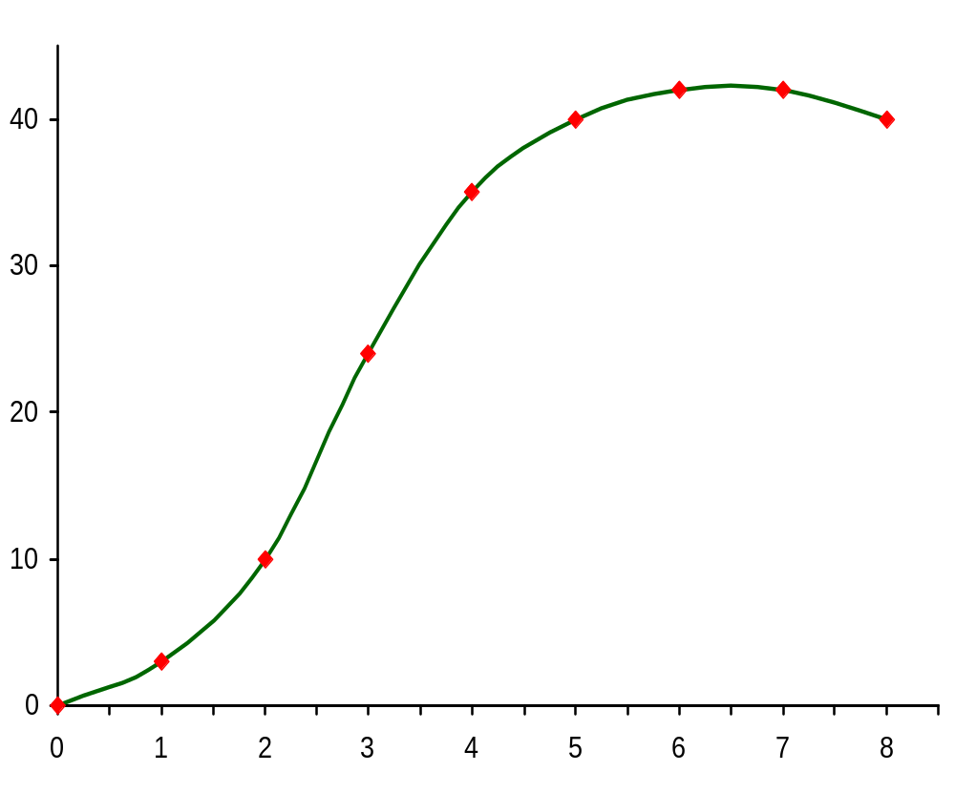
Rice production per year from a particular farm
d
TPP
Maximum output
Tonnes of Rice produced per year
Number of farm workers

Slide 16
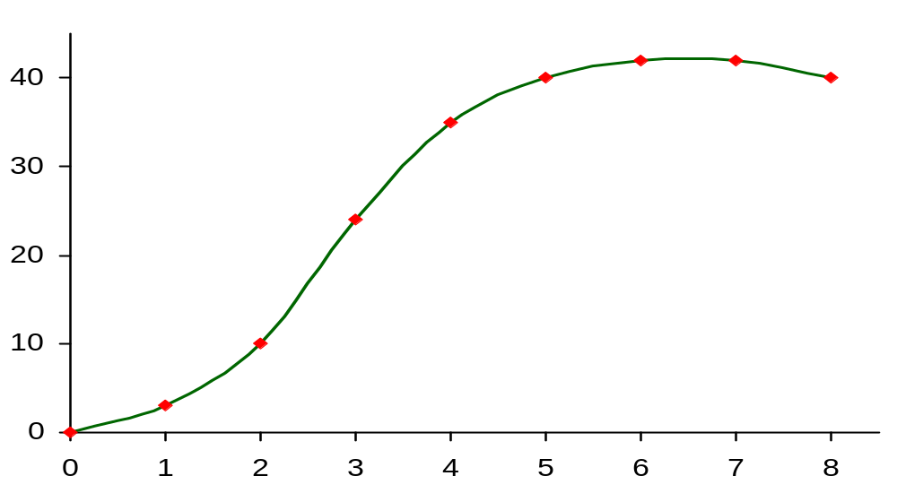
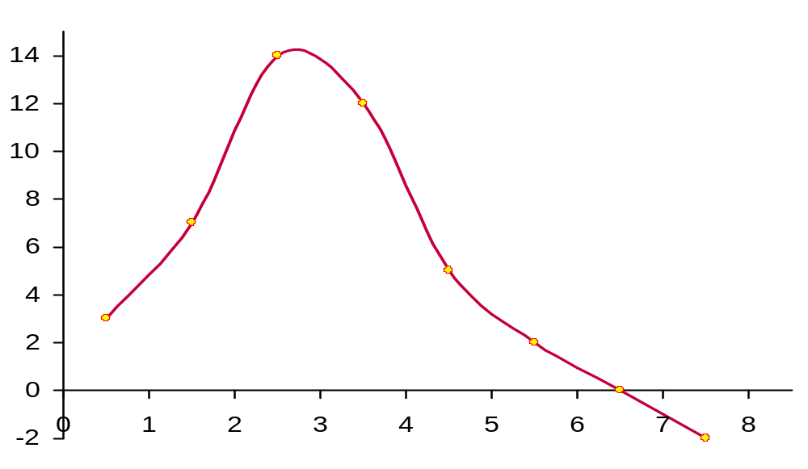
Rice production per year from a particular farm
TPP
Tonnes of Rice per year
Number of
farm workers (L)
Tonnes of Rice per year
Number of
farm workers (L)
MPP

Slide 17
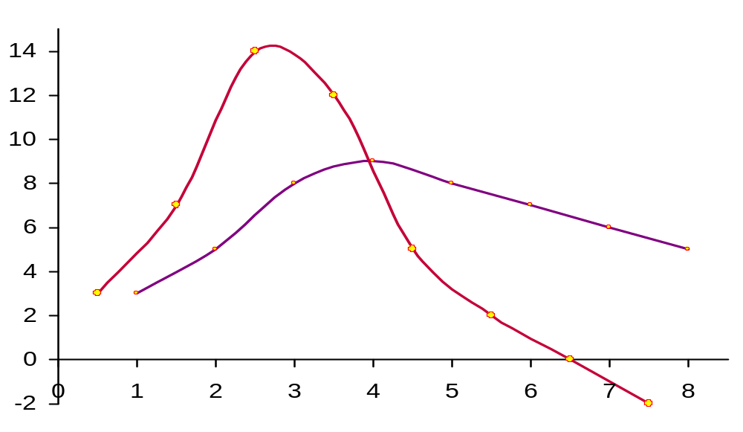

Wheat production per year from a particular farm
TPP
Tonnes of wheat per year
Number of
farm workers (L)
APP = TPP / L
Tonnes of wheat per year
APP
Number of
farm workers (L)
MPP

Slide 18
The Relationship Between The Average and Marginal Product
  If marginal product is above average product, then average product is rising. Thus: If MP > AP then AP is rising.
  If marginal product is below average product, then average product is falling. Thus: If MP < AP then AP is falling.
  Therefore, marginal product equals average product when average product is at a critical value, in this case a maximum.
Thus MP=AP when AP is maximized.

Slide 19
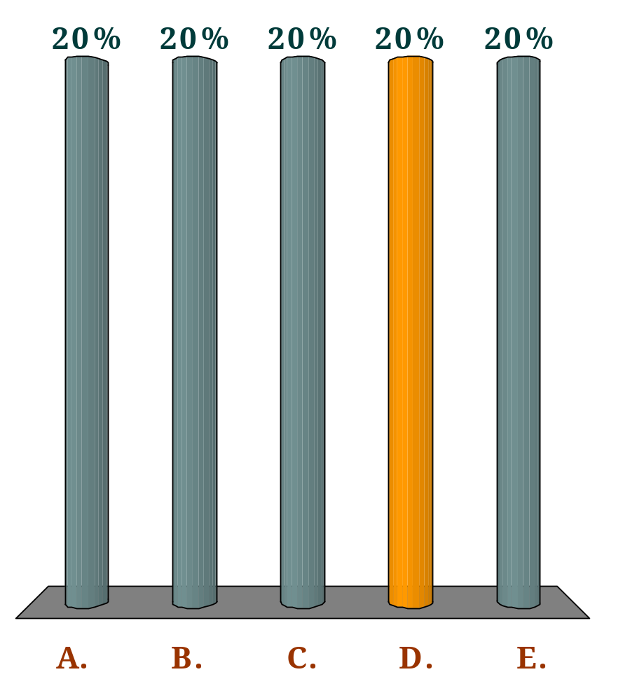
If the marginal physical product (MPP) is above the average physical product (APP):
Q
the MPP must be falling.
the MPP must be rising.
the APP must be falling.
the APP must be rising.
the APP could be either rising or falling depending on whether the MPP is rising or falling.

Slide 20
Production in the long Run
In the long run, the firm can change its fixed inputs by building a larger factory, acquiring bigger machines, etc.
When the firm does these, then we say that the firm is changing its scale of production. There are Three possible outcomes of the changes of the scale of production:
Constant Returns to Scale
Increasing Returns to Scale
Decreasing Returns to Scale

Slide 21
Returns to Scale
Constant Returns to Scale: A property of a production function such that scaling all inputs by any positive constant also scales output by the same constant. Constant returns to scale means that if all factors of production are increased in a given proportion, the output produced would increase in exactly the same proportion. Thus, if the quantities of labour and capital used per unit of time are both increased by 10%, output increases by 10%. Also, if labour and capital are doubled, output doubles.

Slide 22
Returns to Scale
Increasing Returns to Scale: Increasing returns property of a production function such that changing all inputs by the same proportion changes output more than in proportion. Increasing return to scale refers to the case when all factors are increased in a given proportion, output increases in a greater proportion. Thus if labour and capital are increased by 10%, output rises by more than 10%. Also, if labour and capital are doubled, output more than doubles

Slide 23
Returns to Scale
Decreasing Returns to Scale: A property of a production function such that changing all inputs by the same proportion changes output less than the change in inputs in proportion. In other words, we have decreasing returns to scale if output increases in a smaller proportion than the increase in all inputs. This may result because as the scale of operation increases, communication difficulties may make it more and more difficult for the entrepreneur to run a business effectively.
It is generally believed that at very small scale of operation, the firm faces increasing returns to scale

Slide 24
Short-run Costs

Slide 25
Measuring costs of production
There are two costs involved in production:
Explicit costs
Implicit costs
  Explicit costs are the payments by firms to outside suppliers of inputs.
Notes:
9

Slide 26
  Implicit costs: The opportunity costs of using resources owned by the firm. One important implicit cost is the forgone interest of investing the owner’s own capital into the business and the forgone salaries of a business owner managing his own business.
  To the economists, total cost is the sum of Explicit and Implicit cost

Slide 27
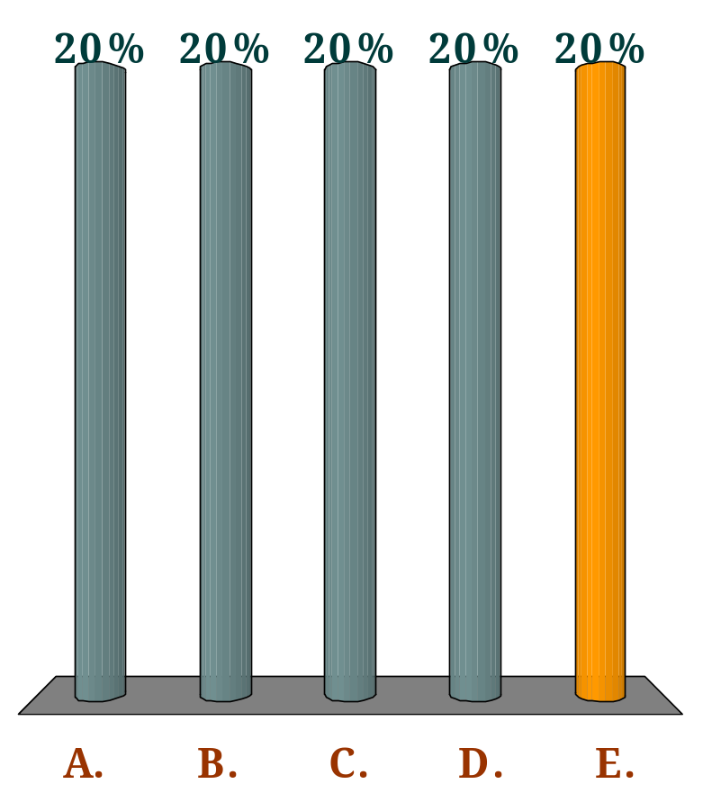
Assume that a firm already owns a machine with a total life of 10 years. The cost of using the machine for one year to produce good X is:
Q
a tenth of what the firm paid for the machine in the first place.
a tenth of what it would cost to replace the machine.
the value of one year’s output of X.
the scrap value of the machine at the end of its life.
the maximum the machine could have earned for the firm in some alternative use during the year in question.

Slide 28
Short-run costs
Total Fixed costs (TFC) are total costs that do not vary with the amount of output produced. These costs are incurred even if the firm is producing nothing. But there are no fixed costs in the long-run.
Total Variable costs (TVC) are total costs that do vary with the amount of output produced.
Total Cost (TC) is the sum of total fixed costs and total variable costs. TC = TVC + TFC
Notes:
9

Slide 29
Short-run Per Unit costs
Average fixed cost (AFC) is the total fixed cost per unit of output: AFC = TFC/Q.
Average variable cost (AVC) is the total variable cost per unit of output: AVC = TVC/Q.
Average total cost (ATC) is the total cost (fixed plus variable) per unit of output: AC = TC/Q = AFC + AVC.
Marginal cost (MC) is the cost of producing one more unit of output: MC = ΔTC/ΔQ.
Notes:
9

Slide 30
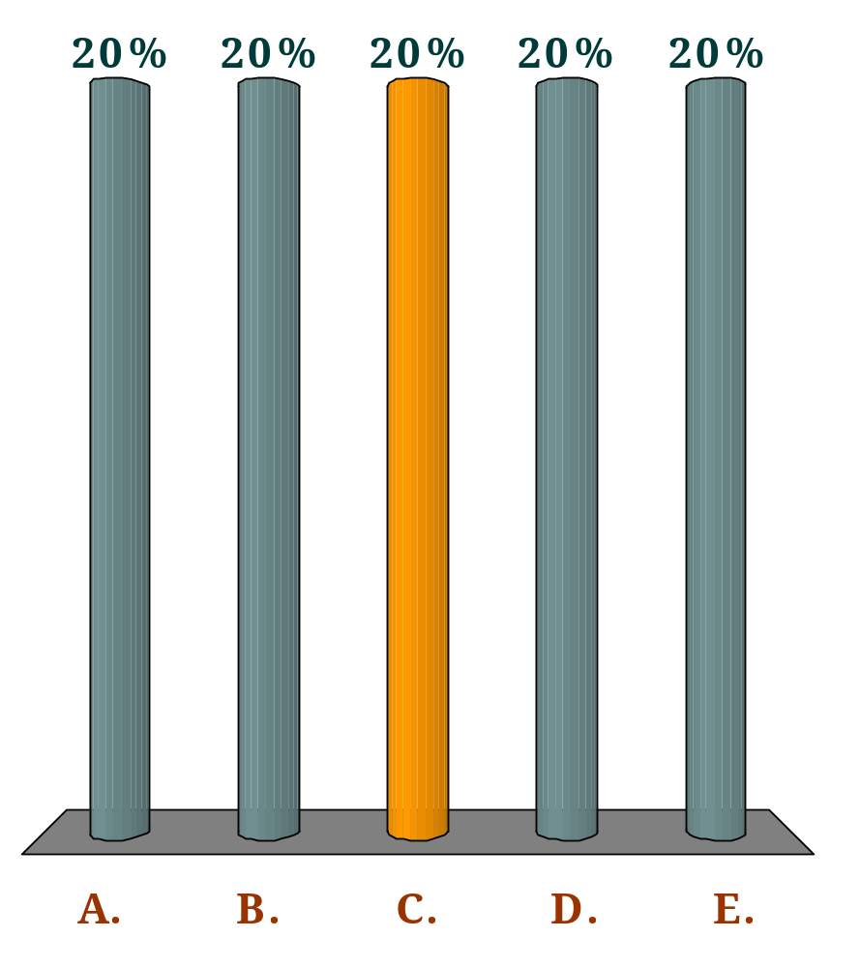
Which one of the following is a fixed cost for a handmade furniture manufacturer?
Q
The cost of wood
Labour costs
The rent on the workshop
The cost of glue and screws
The cost of electricity for running the machines

Slide 31
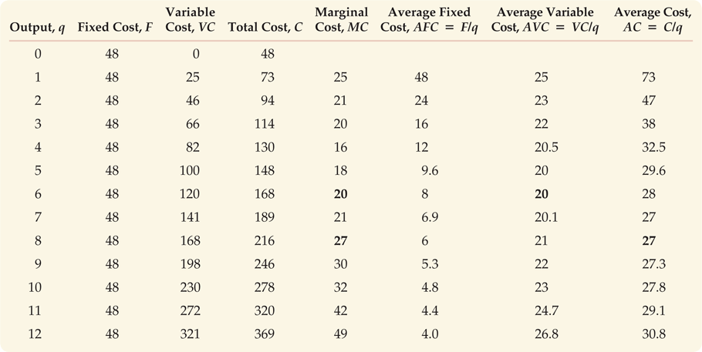

Slide 32
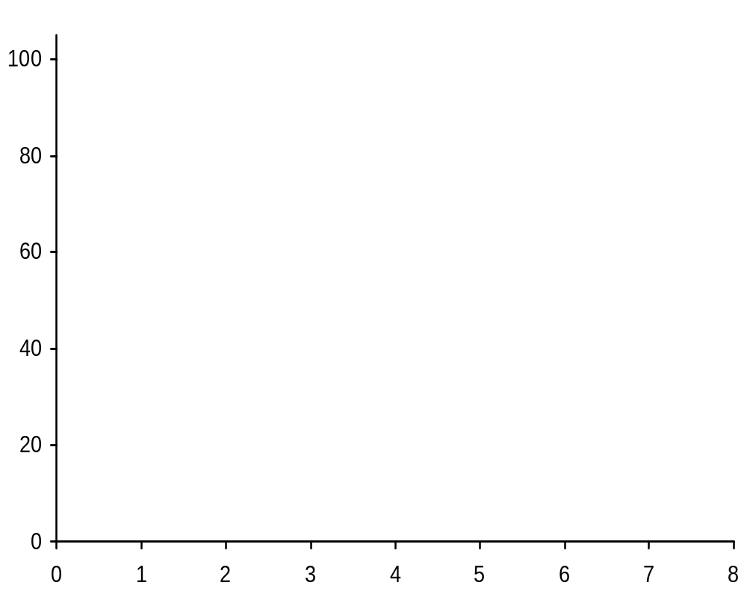
Total costs for firm X
Output
(Q)
0
1
2
3
4
5
6
7
TFC
(GH¢)
12
12
12
12
12
12
12
12

Slide 33
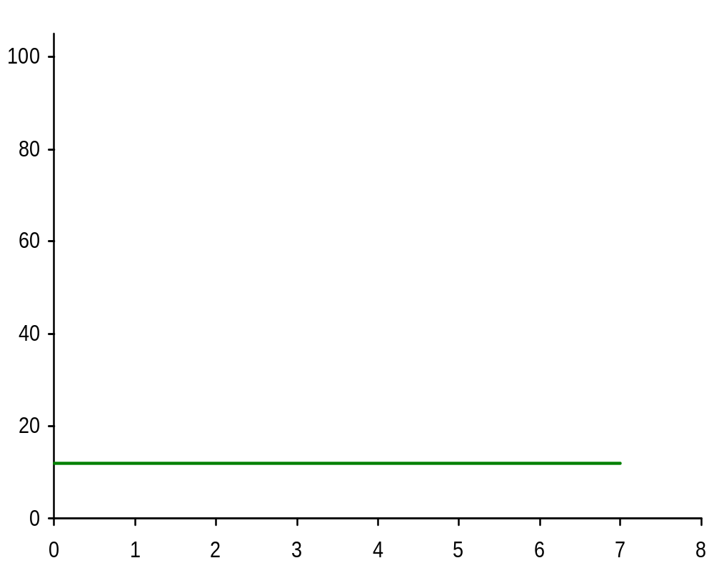
Total costs for firm X
Output
(Q)
0
1
2
3
4
5
6
7
TFC
(£)
12
12
12
12
12
12
12
12
TFC

Slide 34
Total costs for firm X
Output
(Q)
0
1
2
3
4
5
6
7
TFC
(GH¢)
12
12
12
12
12
12
12
12
TVC
(GH¢)
0
10
16
21
28
40
60
91
TFC

Slide 35
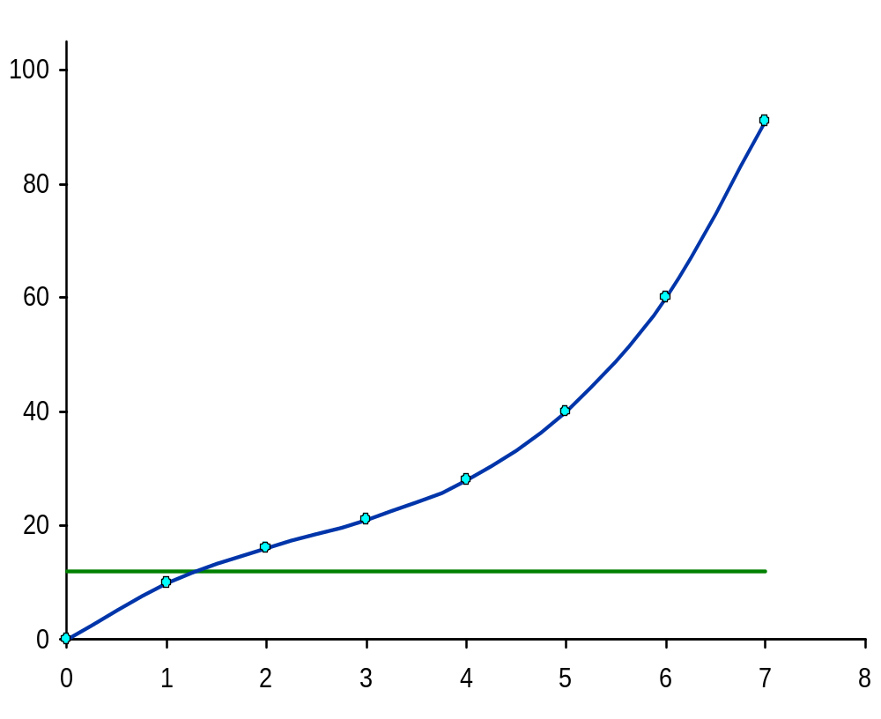
Total costs for firm X
Output
(Q)
0
1
2
3
4
5
6
7
TFC
(GH¢)
12
12
12
12
12
12
12
12
TVC
(GH¢)
0
10
16
21
28
40
60
91
TVC
TFC

Slide 36
Total costs for firm X
Output
(Q)
0
1
2
3
4
5
6
7
TFC
(GH¢)
12
12
12
12
12
12
12
12
TVC
(GH¢)
0
10
16
21
28
40
60
91
TC
(GH¢)
12
22
28
33
40
52
72
103
TVC
TFC

Slide 37
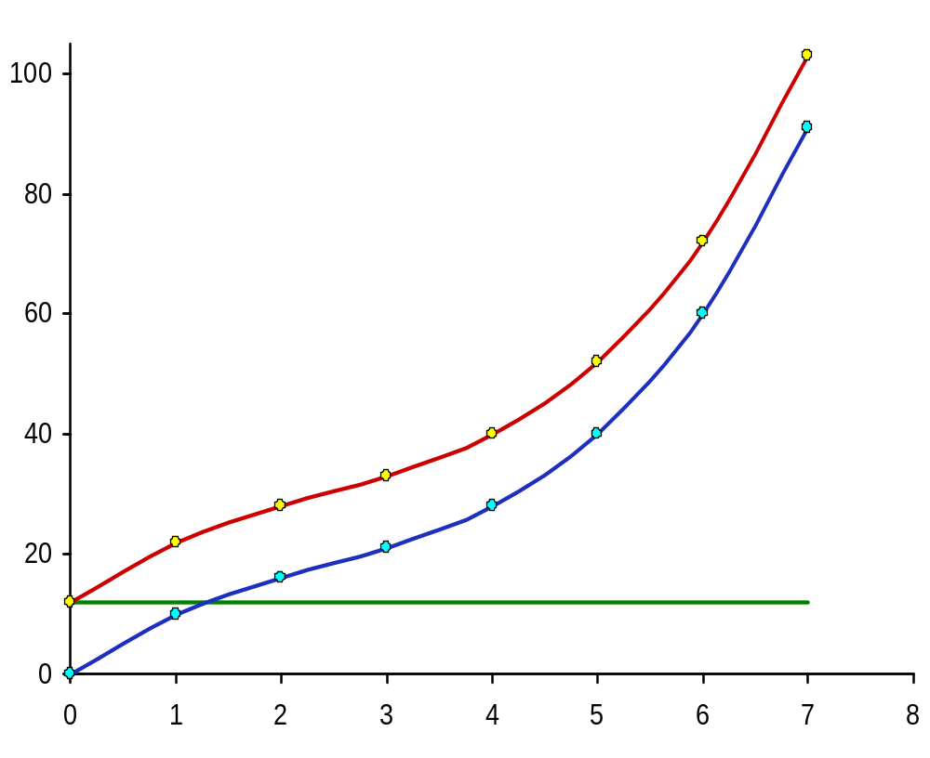
Total costs for firm X
Output
(Q)
0
1
2
3
4
5
6
7
TFC
(GH¢)
12
12
12
12
12
12
12
12
TVC
(GH¢)
0
10
16
21
28
40
60
91
TC
(GH¢)
12
22
28
33
40
52
72
103
TC
TVC
TFC

Slide 38
Total costs for firm X
TC
TVC
TFC

Slide 39
Relationship between marginal and total cost curves
MCs reflect changes in variable costs because fixed costs do not change when output changes in the short-run.
Thus, the slope of the TVC curve is equal to the MC
When MC is declining, TVC increases but at a decreasing rate.
When MC increases, TVC continues to increase but at an increasing rate. Thus, the TVC curve gets steeper.
  The TVC curve always has a positive slope.
The TC curve is simply the TVC curve shifted vertically upwards by the amount of the FC.
Notes:
10

Slide 40
Marginal cost and the law of diminishing returns
  The shape of the MC curve follows directly from the law of diminishing returns. As more of the variable factor is used, extra units of output cost less than previous units. MC falls. This corresponds to the rising portion of the MPP curve.
  Beyond a certain level of output, diminishing returns set in. Thereafter MC rises as MPP falls. Additional units of output cost more and more to produce, since they require ever increasing amounts of the variable factor.
Notes:
10

Slide 41
Marginal cost
MC
Costs (£)
Output (Q)

Slide 42
Average and marginal costs
MC
AC
AVC
Costs (£)
z
y
x
AFC
Output (Q)

Slide 43
Relationship amongst MC, ATC, AVC and AFC
If MC is less than ATC, ATC must be falling.
If MC is greater than ATC, ATC must be rising.
The MC crosses the ATC at its minimum point.
Since all marginal costs are variable, the same relationship holds between MC and AVC.
AVC and ATC get closer together as output increases, but the two lines never meet because as AFC falls with output, an ever-declining amount is added to AVC.
AFC falls continuously since total fixed costs are being spread over a greater and greater output.
Notes:
10

Slide 44
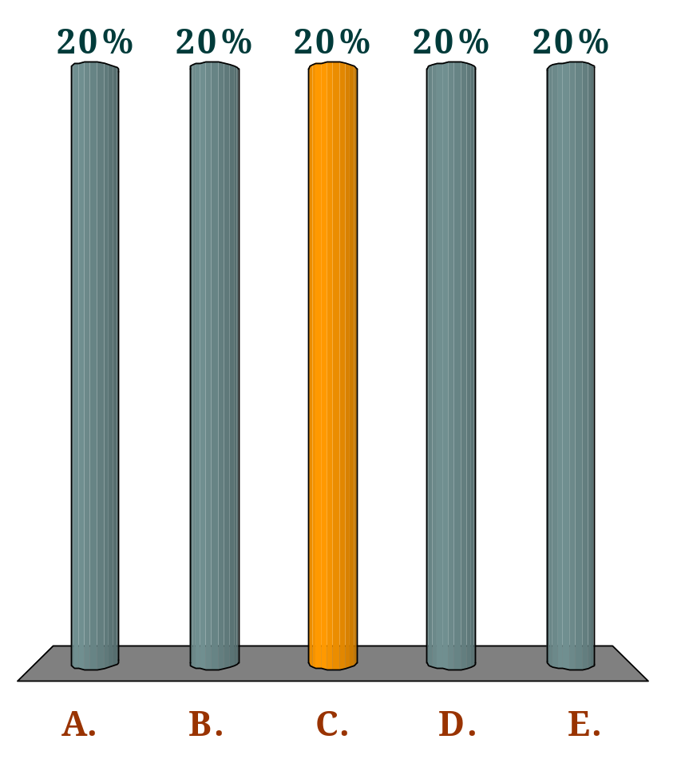
If the marginal cost is below the average cost, then:
Q
the marginal cost must be falling.
the marginal cost must be rising.
the average cost must be falling.
the average cost must be rising.
the average cost could be either rising or falling depending on whether the marginal cost is rising or falling.

